Slide 1
A New Era
A New Decade
A New Heart
Ludwig
03/02/20

Slide 2
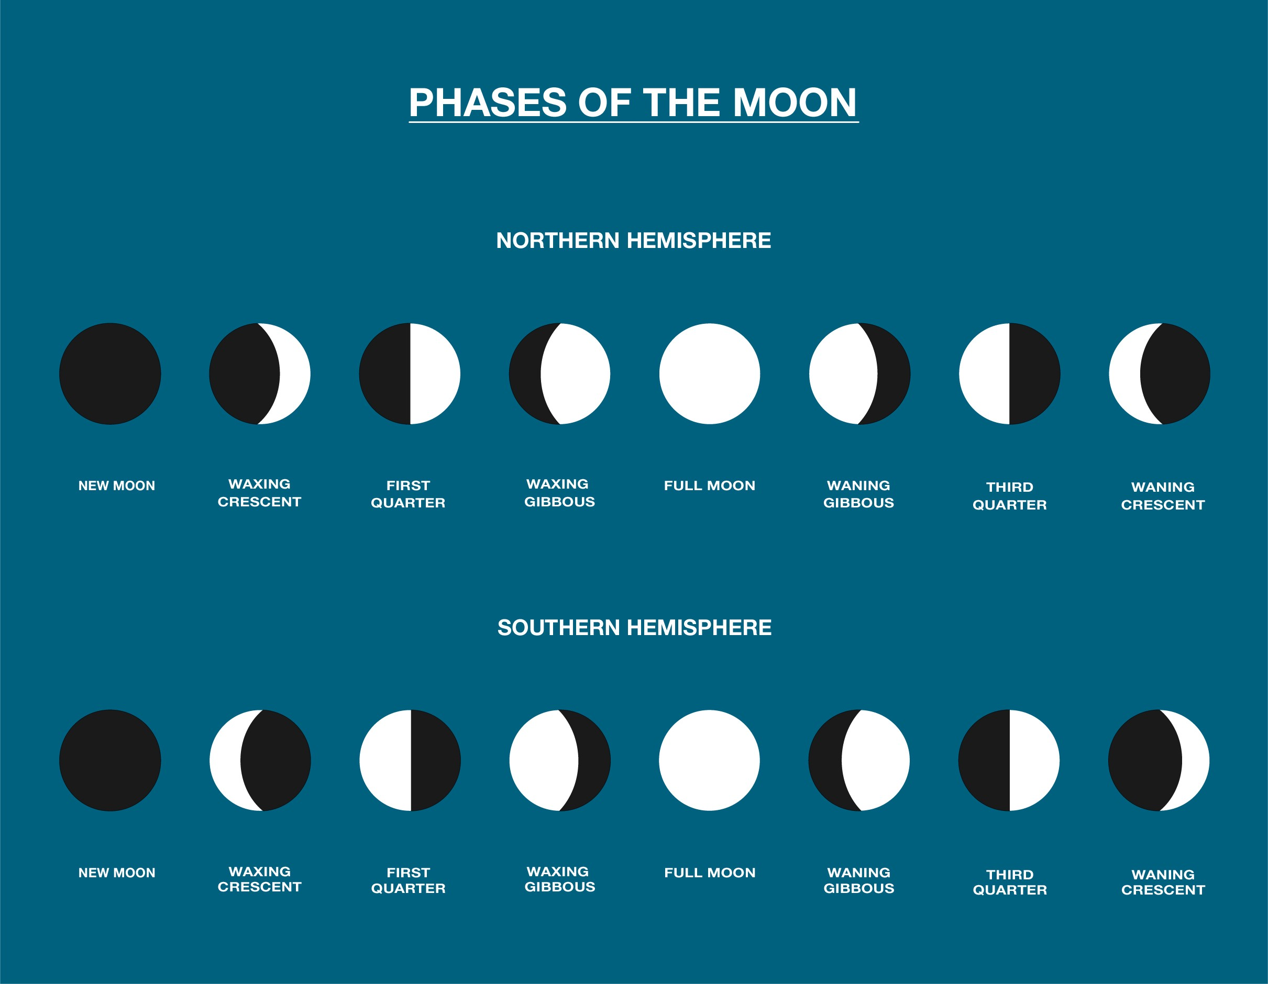
A New Moon is the beginning of a month
“Month” or “new moon” in Hebrew is “Chodesh”
The “New” in Hebrew is “Chadash”
“New Moon” and “New” shares the same root word
חדש

Slide 3
Introduction
The New is not new to God but new to us
The New is better and greater
The New brings fulfilment to the old
The New brings us to perfection or maturity (new level)

Slide 4
John 3:1-10
¹ There was a man of the Pharisees named Nicodemus, a ruler of the Jews.
² This man came to Jesus by night and said to Him, “Rabbi, we know that You are a teacher come from God; for no one can do these signs that You do unless God is with him.”
³ Jesus answered and said to him, “Most assuredly, I say to you, unless one is born again, he cannot see the kingdom of God.”
⁴ Nicodemus said to Him, “How can a man be born when he is old? Can he enter a second time into his mother’s womb and be born?”

Slide 5
⁵ Jesus answered, “Most assuredly, I say to you, unless one is born of water and the Spirit, he cannot enter the kingdom of God. ⁶ That which is born of the flesh is flesh, and that which is born of the Spirit is spirit. ⁷ Do not marvel that I said to you, ‘You must be born again.’
⁸ The wind blows where it wishes, and you hear the sound of it, but cannot tell where it comes from and where it goes. So is everyone who is born of the Spirit.”
⁹ Nicodemus answered and said to Him, “How can these things be?”
¹⁰ Jesus answered and said to him, “Are you the teacher of Israel, and do not know these things?

Slide 6
Luke 5:33, 37-39
³³ Then they said to Him, “Why do the disciples of John fast often and make prayers, and likewise those of the Pharisees, but Yours eat and drink?”
…
Pharisees
John’s Disciples
Jesus’ disciples

Slide 7
Luke 5:37-39
³⁷ And no one puts new wine into old wineskins; or else the new wine will burst the wineskins and be spilled, and the wineskins will be ruined.
³⁸ But new wine must be put into new wineskins, and both are preserved.
³⁹ And no one, having drunk old wine, immediately desires new; for he says, ‘The old is better.’ ”

Slide 8

New Wine will Stretch us

Slide 9
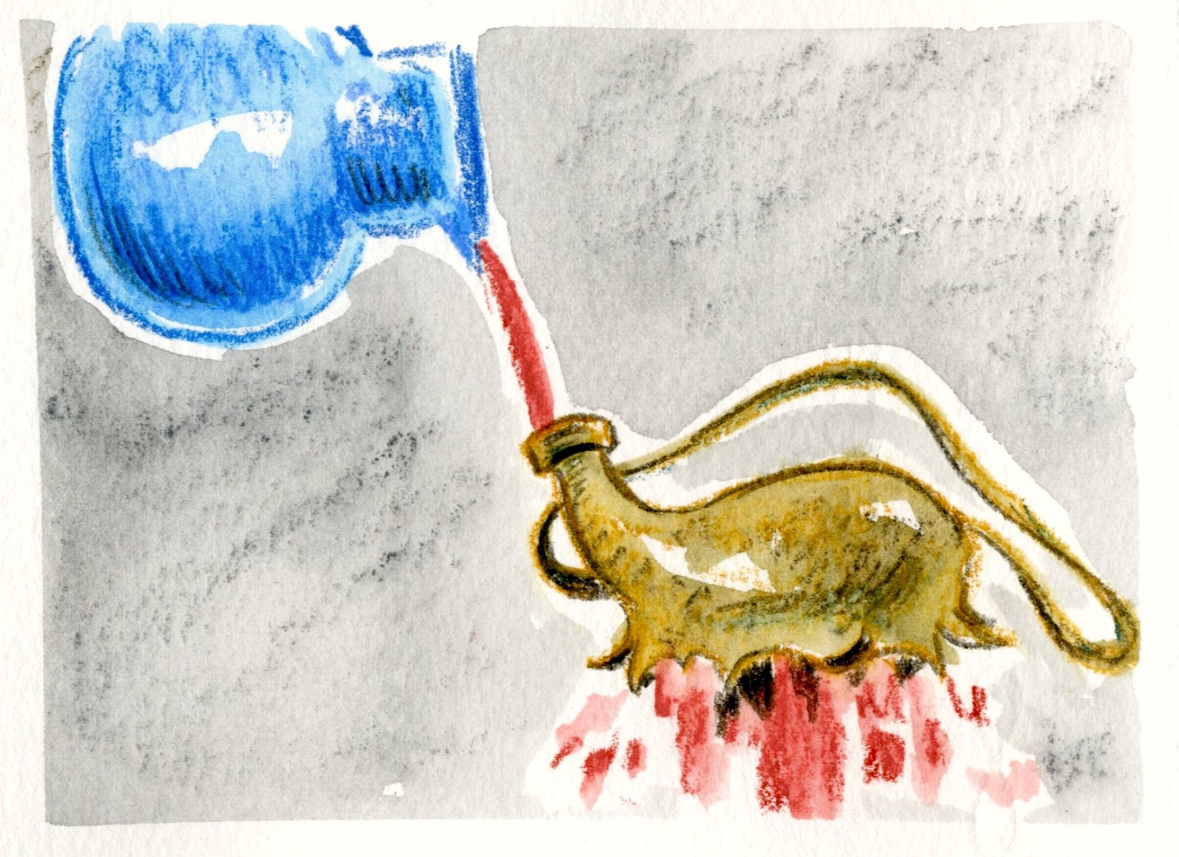

Slide 10

LIMITED

Slide 11

UNLIMITED
Set the eyes of our heart on Jesus

Slide 12
2 Corinthians 5:17
¹⁷ Therefore, if anyone is in Christ, he is a
new creation; old things have passed away; behold,
all things have become
new.
I want to live and stay in the NEW

Slide 13
Ezekiel 36:26
²⁶ I will give you a new heart and put a new spirit within you; I will take the heart of stone out of your flesh and give you a heart of flesh.
God gave us a new heart and a new spirit so that in the New Covenant, He may write His law on our hearts and put them in our minds.

Slide 14
Psalms 22:3-4
³ Who may ascend into the hill of the Lord?
Or who may stand in His holy place?
⁴ He who has clean hands and a pure heart,
Who has not lifted up his soul to an idol,
Nor sworn deceitfully.

Slide 15
Psalm 19:14
¹⁴ Let the words of my mouth and the meditation of my heart
Be acceptable in Your sight,
O Lord, my strength and my Redeemer.

Slide 16
Psalm 51:1-19
¹Have mercy upon me, O God,
According to Your lovingkindness;
According to the multitude of Your tender mercies,
Blot out my transgressions.
² Wash me thoroughly from my iniquity,
And cleanse me from my sin.
³ For I acknowledge my transgressions,
And my sin is always before me.

Slide 17
⁴ Against You, You only, have I sinned,
And done this evil in Your sight—
That You may be found just when You speak,
And blameless when You judge.
⁵ Behold, I was brought forth in iniquity,
And in sin my mother conceived me.
⁶ Behold, You desire truth in the inward parts,
And in the hidden part You will make me to know wisdom.
⁷ Purge me with hyssop, and I shall be clean;
Wash me, and I shall be whiter than snow.

Slide 18
⁸ Make me hear joy and gladness,
That the bones You have broken may rejoice.
⁹ Hide Your face from my sins,
And blot out all my iniquities.
¹⁰ Create in me a clean heart, O God,
And renew a steadfast spirit within me.
¹¹ Do not cast me away from Your presence,
And do not take Your Holy Spirit from me.
¹² Restore to me the joy of Your salvation,
And uphold me by Your generous Spirit.
¹³ Then I will teach transgressors Your ways,
And sinners shall be converted to You.

Slide 19
¹⁴ Deliver me from the guilt of bloodshed, O God,
The God of my salvation,
And my tongue shall sing aloud of Your righteousness.
¹⁵ O Lord, open my lips,
And my mouth shall show forth Your praise.
¹⁶ For You do not desire sacrifice, or else I would give it;
You do not delight in burnt offering.
¹⁷ The sacrifices of God are a broken spirit,
A broken and a contrite heart—
These, O God, You will not despise.

Slide 20
¹⁸ Do good in Your good pleasure to Zion;
Build the walls of Jerusalem.
¹⁹ Then You shall be pleased with the sacrifices of righteousness,
With burnt offering and whole burnt offering;
Then they shall offer bulls on Your altar.

Slide 21
Colossians 3:23
²³ And whatever you do, do it heartily, as to the Lord and not to men,

Slide 22
1 Peter 1:22
²² Since you have purified your souls in obeying the truth through the Spirit in sincere love of the brethren, love one another fervently with a pure heart,

Slide 23
Ephesians 3:14-19
¹⁴ For this reason I bow my knees to the Father of our Lord Jesus Christ,
¹⁵ from whom the whole family in heaven and earth is named,
¹⁶ that He would grant you, according to the riches of His glory, to be strengthened with might through His Spirit in the inner man,

Slide 24
¹⁷ that Christ may dwell in your hearts through faith; that you, being rooted and grounded in love,
¹⁸ may be able to comprehend with all the saints what is the width and length and depth and height—
¹⁹ to know the love of Christ which passes knowledge; that you may be filled with all the fullness of God.

